Slide 1
Different types of Operators

Slide 2
Operators
Symbol that indicates the operation or activity to be performed.
Example
+ means addition like A+B
Here, A,B called operands
+ called operator

Slide 3
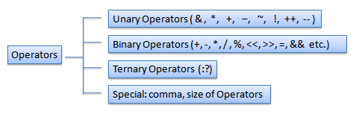
Operators
Unary operator : single operand only, like ++A, -A
Binary operator : double operand only, like A+B, A/B
Ternary operator : triple operand only, like A?B:C

Slide 4
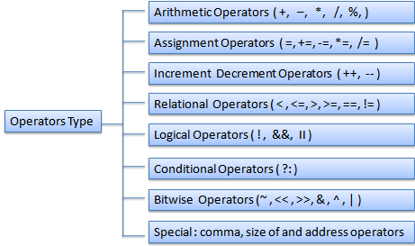
Types of Operator

Slide 5
Arithmetic Operators
Performs arithmetic operations
Operator | Example | Result
+ | 20 + 10 | 30
- | 20 – 10 | 10
* | 20 * 10 | 200
/ | 20 / 10 | 2
% | 20 % 10 | 0

Slide 6
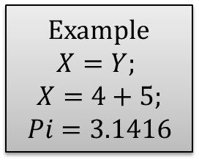
Assignment Operators
It copy/store, thus assigning value
hence the name is assignment operator.
Syntax : Variable = expression
Example
$$X=Y;$$
$$X=4+5;$$
$$Pi=3.1416$$

Slide 7
Shorthand Operators
A = A + 20
A += 20
Operator | Before | Example | Meaning | After
+= | A=20 | A += 20 | A=A+20 | 40
-= | A=20 | A -= 20 | A=A-20 | 0
/= | A=20 | A /= 20 | A=A/20 | 1
*= | A=20 | A *= 20 | A=A*20 | 400

Slide 8
Increment/Decrement Operators
++A
(Pre-increment)
A = A + 1
A++
(Post-increment)

Slide 9
Increment/Decrement Operators
Operator | Before | Example | Output | After
++ | A=20 | printf(“%d” , A++) | 20 | A=21
++ | A=20 | printf(“%d” , ++A) | 21 | A=21
-- | A=20 | printf(“%d” , A--) | 20 | A=19
-- | A=20 | printf(“%d” , --A) | 19 | A=19

Slide 10
Relational Operators
Used to compare two operands
Operator | Example | Output
== | 4 == 4 | 1 (True)
> | 5>2 | 1
>= | 4 >= 4 | 1
< | 2 < 0 | 0
<= | 8 <= 6 | 0
!= | 4 != 5 | 1

Slide 11
Logical Operators
&& (AND operation)
In C form : condition-1 && condition-2
Example :
Operator | Condition-1 | Condition-2 | Result
&& (AND) | True | True | True
 | True | False | False
 | False | True | False
 | False | False | False

Slide 12
Logical Operators
|| (OR operation)
In C form : condition-1 || condition-2
Example :
Operator | Condition-1 | Condition-2 | Result
| (OR) | True | True | True
 | True | False | True
 | False | True | True
 | False | False | False

Slide 13
Logical Operators
! (NOT operation)
In C form : !condition-1
Example :
Operator | Condition-1 | Result
! (NOT) | True | False
 | False | True

Slide 14
Conditional Operator
Also known as ternary operator.
Syntax : Exp1 ? TRUE : FALSE ;
x=10;
y=20;
max = (x > y) ? x : y;

Slide 15
Bitwise Operator
Bit |  | Expression
A | B | A & B | A | B | ~A | A ^ B
1 | 1 | 1 | 1 | 0 | 0
1 | 0 | 0 | 1 | 0 | 1
0 | 1 | 0 | 1 | 1 | 1
0 | 0 | 0 | 0 | 1 | 0

Slide 16
Special Operators
Comma operator
int x, y=20, z;
sizeof operator
Give size of particular variable in memory
Example:
sizeof(char) is 1 byte
sizeof(int) is 2 bytes
Address operator (&)

Slide 17
That’s all

